Slide 1
Interfacing with Excel and R
Coffee and Coding
February 2019
Matt Funnell

Slide 2
Contents
Package Options
Reading .csv files
Reading .xlsx files
Writing .xlsx files
Styling outputs (basic)
Reading a table template
Styling outputs (further)
Further Resources and Options
Matt Funnell – Criminal Justice System Analysis, FSAS

Slide 3
1.a There are loads of options for reading/writing data from/to Excel in R
R is open-source – anyone can develop and release a package on CRAN
Built in package ‘utils’ allows csv/data frame reading
We’ll touch on three packages in this presentation:
  ‘readr’ – from the tidyverse
  ‘openxlsx’
  ‘XLConnect’
  Caveat – packages are chosen solely because they do what I need them to do!
  Caveat – covering reading / writing / styling – not how to reproduce excel analysis in R
Notes:
We can’t/won’t cover everything and I’m not an expert!

Slide 4
1.b Code along – clone the github repo into R
From moj-analytical-services, clone the github repo ‘r-excel-training’ to work through with training datasets
If you can’t don’t know how to clone – we don’t have time to go through now (sorry!).
Future training opportunities planned to work through this at a code-along pace

Slide 5
2. Reading in a csv is straightforward and nearly every user will do it as a matter of course
Make sure you’re in the right working directory! In readr/utils:
Col_names – default interprets first row of data as column names
Col_types – override type interpretation, e.g. character / dates / numeric
Column name = col_type
Notes:
We can also just use the ‘import data’ GUI button in R (this implicitly runs this code or a version thereof)
Col_types needs to be a vector of length of number of columns (i.e. we need to specify all)
Also write_csv and write.csv for vice versa

Slide 6
2. To write to csv we use the opposite commands:
Utils – write.csv
Readr – write_csv
Specify:
X – dataset to be written
Filepath to write to (writes into working directory if we don’t specify the long form of this
We can also decide if we want column names to be appended or not (default not)
Notes:
Also write_csv and write.csv for vice versa

Slide 7
3.a A .xlsx file is a workbook with multiple sheets therefore we need a more complicated object / structure in R
Install / load ‘openxlsx’ and ‘XLConnect’ to work with .xlsx files
As well as file path, we need to say what sheet of the workbook to read
As an alternative, we read in the entire workbook, then access sheets from this when we need them

Slide 8
3.b Extra – if we need to quickly get the names of the sheets as a vector…

Slide 9
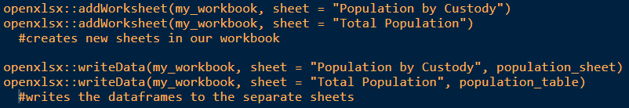
4.a To write data back out excel, we manipulate the workbook object in R and then write the entire workbook
Start with a blank workbook
(If coding along, manipulate the data from earlier to make something to write)
Now add some worksheets to our workbook; and write the data to these separately:
Notes:
Note we’ve only added these to the workbook object, not saved them out to excel

Slide 10
4.b Once we’ve manipulated the workbook, we need to save to Excel
Save the workbook to excel using ‘openxlsx’ (other packages can also do this)
Workbook object in R
Excel file name
Notes:
Excel file name needs to be brand new (or can use if statement – see later)

Slide 11
5.a We’ve written data in place so far. But we want our tables to look pretty as well…
‘createStyle’ from openxlsx makes a style type…
…then ‘addStyle’ adds it to our workbook object. Note we do this after data has been written, but before saving the workbook to an excel file (obviously).
Important: gridExpand = TRUE
Important: stack = TRUE
Notes:
gridExpand – applies to all combinations of columns and rows
Stack – merge existing cell styles, don’t overwrite

Slide 12
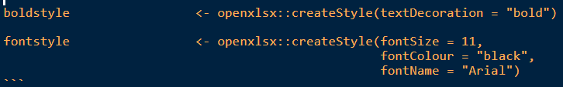
5.b Simple examples
Create Style
Notes:
Loads of options here – more later

Slide 13
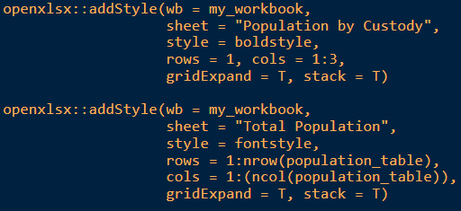
5.b Simple examples
Add it to worksheet
Notes:
Specify workbook and sheet; created style
Rows/columns – combinations – second example uses nrow/ncol to adapt to size of table
Grid expand and stack!

Slide 14
5.b Simple examples
Write it to excel to check styling:
Notes:
Use this as standard – as we already created the file – we want to overwrite
So if exists – remove and re-write. R will throw an error otherwise!

Slide 15
6. We can use a template .xlsx file to use standard text/data around our dynamic output
The template allows for us to use standard headers and pre-information, before writing in new data each quarter/year/iteration
If writing to the template, we specify the start row / column when writing data:
Start row / col for writing data

Slide 16
6. Write to excel to check

Slide 17
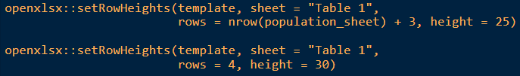
7.a We saw some basic styles earlier – here’s a few more things we can control in excel from R
(If coding along, manipulate the data from earlier to arrange by year)
Creating white space – set row and column heights

Slide 18
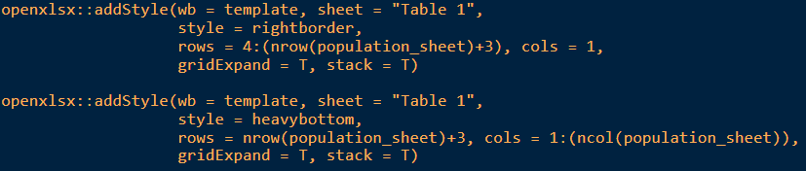
7.b Cell borders….
Create styles
Add styles

Slide 19
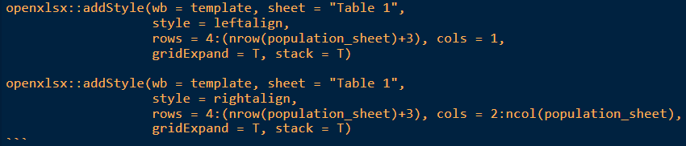
7.c Text alignment….
Create styles
Add styles

Slide 20


7.d Number formatting and wrapping text
Create styles
Add styles

Slide 21
8.a Further Resources - xltabr
The MoJ has created a bespoke package for writing cross-tabulations to excel, for publication purposes.
This also includes formatting and styling of the tables, and is available on CRAN
For more information, please visit the github page for xltabr https://github.com/moj-analytical-services/xltabr and follow the instructions contained in the README
Or talk to Karik (sorry Karik)

Slide 22
8.b Some other resources
Package queries?
XLConnect - http://www.milanor.net/blog/steps-connect-r-excel-xlconnect
readr - https://readr.tidyverse.org
General questions - https://stackoverflow.com/
Queries on this material?
- Contact Matt: matthew.funnell@justice.gov.uk
Suggestions for improvements?
Raise an issue on the github repository, or email Matt as above.
We will be using this material as a future training resource so feedback greatly appreciated and benefits future learners!

Slide 23
9. Any Questions? Thanks for listening
Future presenter? Ideas for topics to cover?
Get in touch with the team at coffee-and-coding@justice.gov.uk

